Slide 1


IntelliHome: Advancing Smart Living through IoT-Based Home Automation
Instructor: Dr. Md Moinuddin Bhuiyan
Name:
1. Snehal Bharat Jadhav (00798842)
2. Nishchal Sreevathsa (00803363)
Department: Cyber Security and Networks

Slide 2

AGENDA
Introduction
What is IntelliHome?
Internet of Things
Implementation of a Secure IntelliHome Automation System
Advantages
Applications
Conclusion

Slide 3
Introduction:
The number of home appliances that can be controlled remotely is growing daily. This talk will go over some of the current and potential uses.
Home automation makes our lives easier and simpler, and it can save energy as well.
In a real-time environment, we monitor and control the load using a webpage with a user-configurable front end.
The "Internet of Things," where everything has an IP address and can be monitored and accessed remotely, is one step closer to reality with home automation.

Slide 4

What is IntelliHome Automation System?
IntelliHome automation is a method of utilizing cutting-edge technology to improve the security and efficiency of houses. Through the network connection of devices and appliances, homeowners can use their PCs, cellphones, or voice-activated assistants such as Google Assistant or Amazon Alexa to remotely operate their homes.
In addition to monitoring energy usage and detecting security breaches, this technology also sends out real-time notifications, which facilitates easier home management and less environmental impact for homeowners.
The development of load control is the project's primary goal.

Slide 5
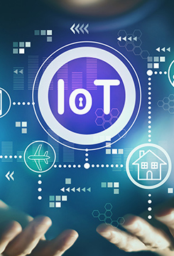
Internet Of Things:
One of the most important technologies in recent years is the Internet of Things.
It is now feasible for people and technology to communicate continuously thanks to gadgets like the Water Level Monitor, cars, and home appliances that link to the internet via embedded electronics.
The phrase "Internet of Things" (IoT) refers to a network of physical objects, such as appliances in homes and other products, that have connectivity and software installed so they can collect and share data online.

Slide 6
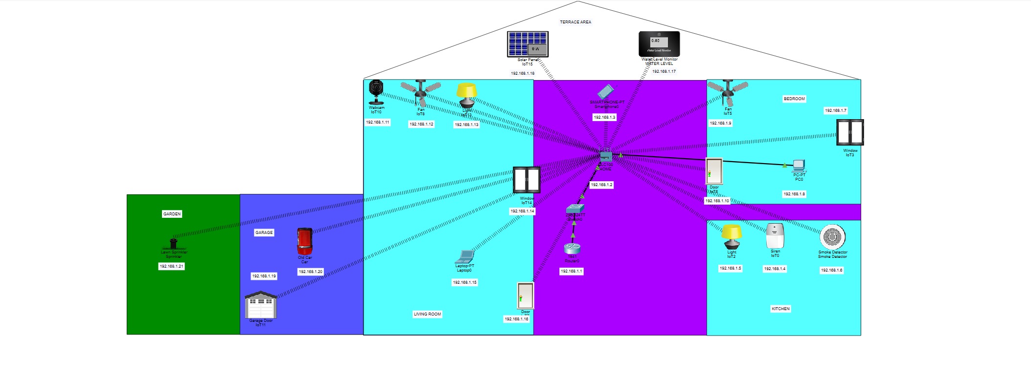
Implementation Topology:

Slide 7

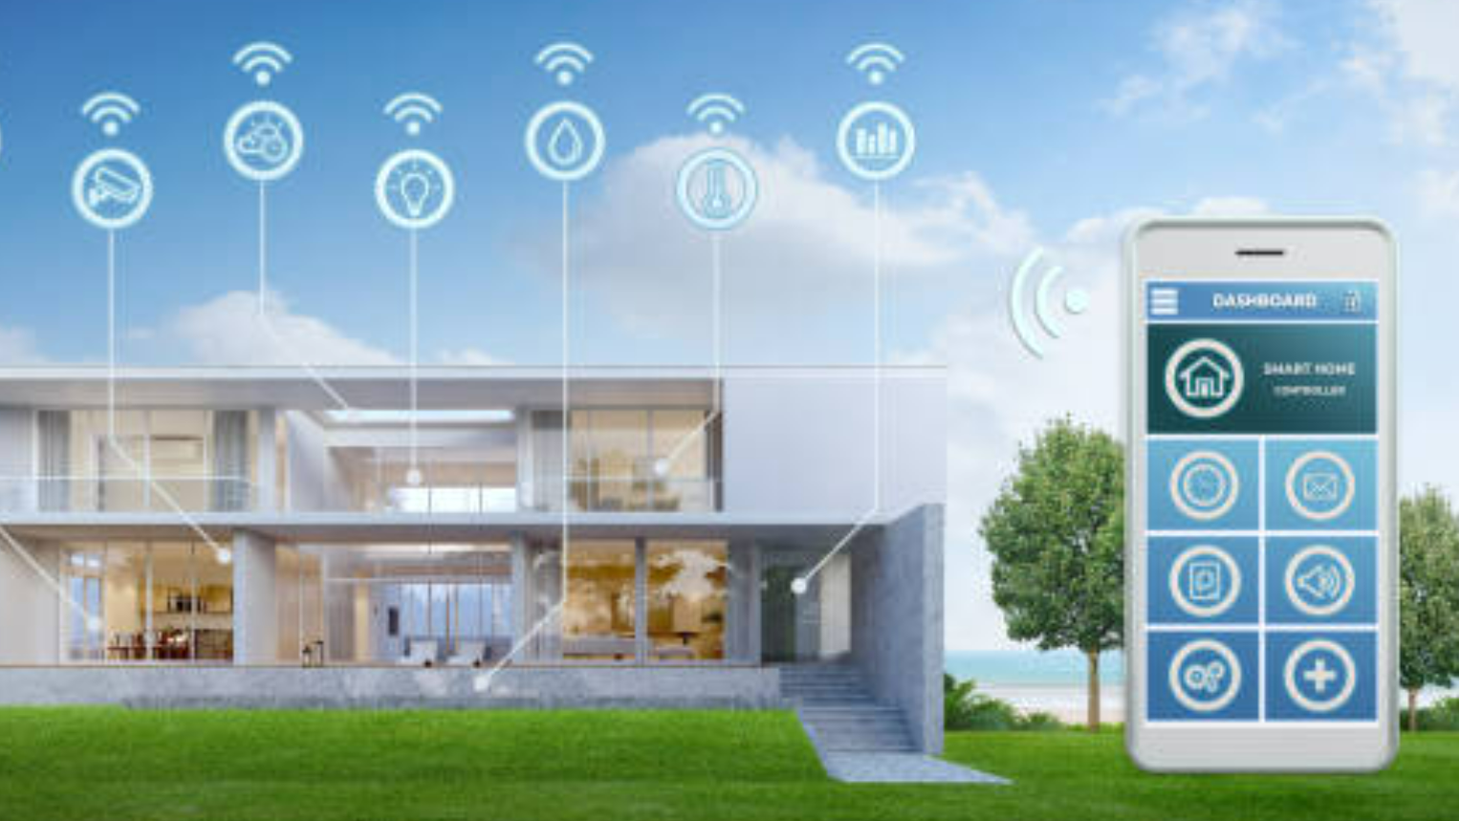

Devices Real-Time Monitoring and Controlling.

Slide 8
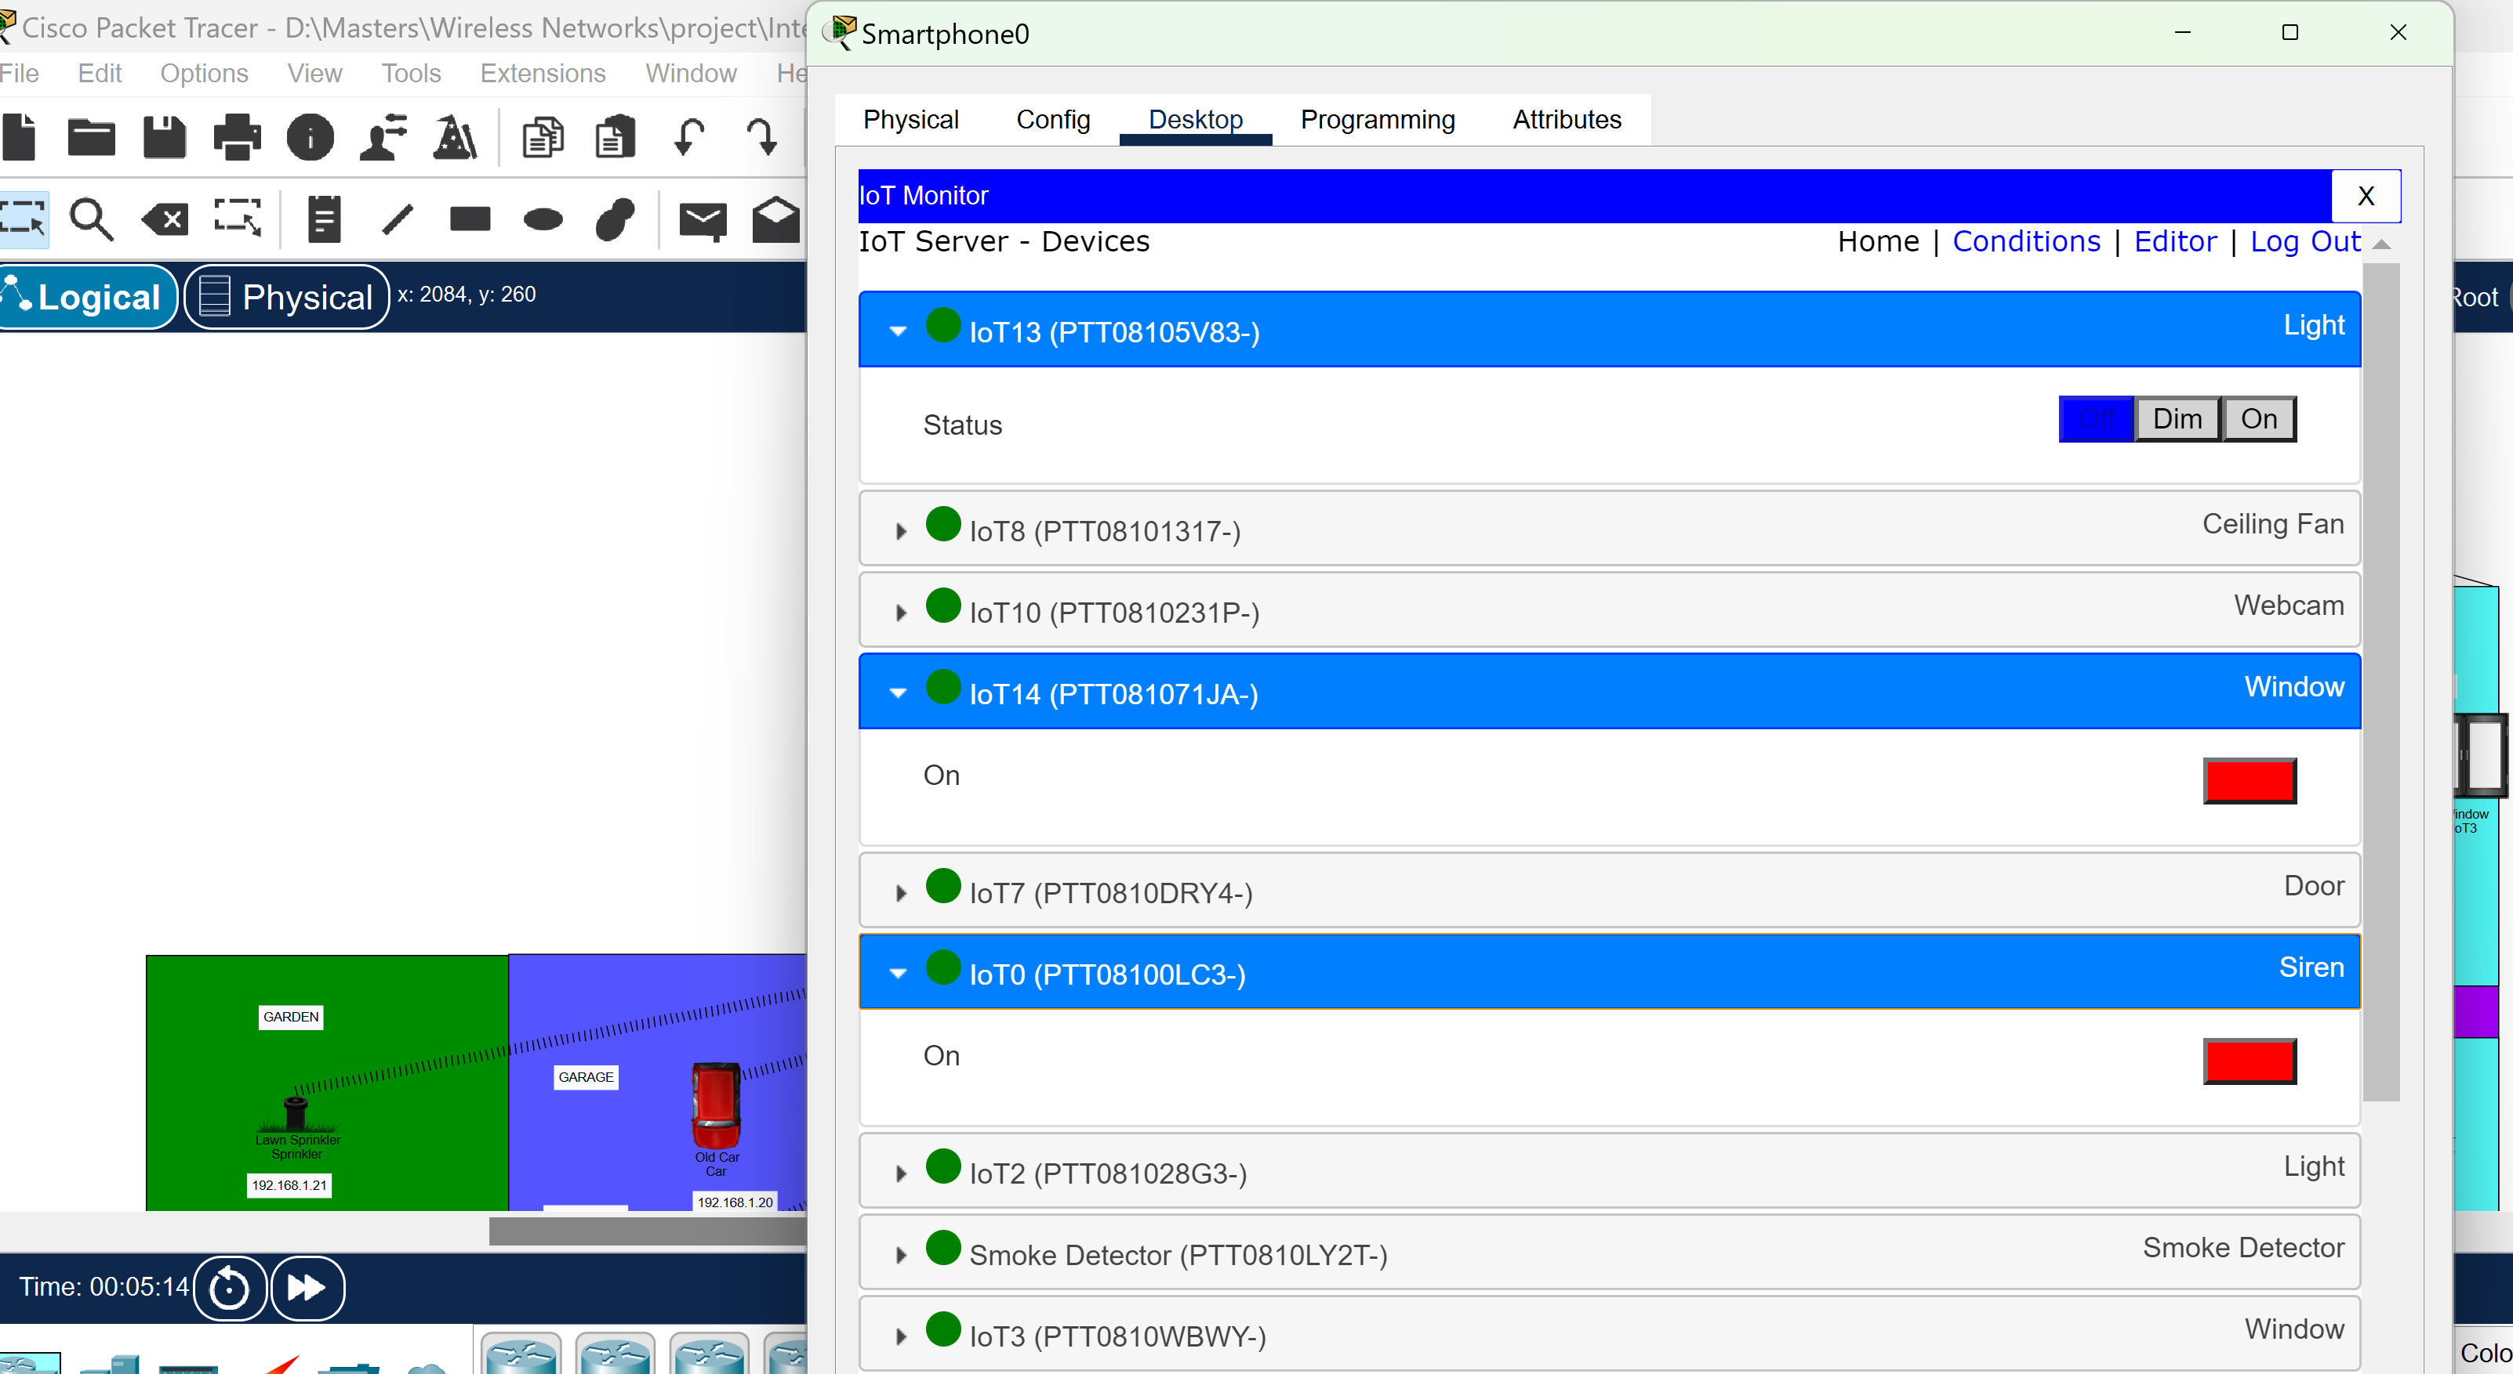
Modeling the Simulation Environment:

Slide 9
Advantages:
Enhanced convenience and comfort.
Energy savings and reduced utility bills.
Improved safety and security.
Customized automation based on personal preferences and routines.
The value of the home will be increased when they appeal to potential buyers.

Slide 10
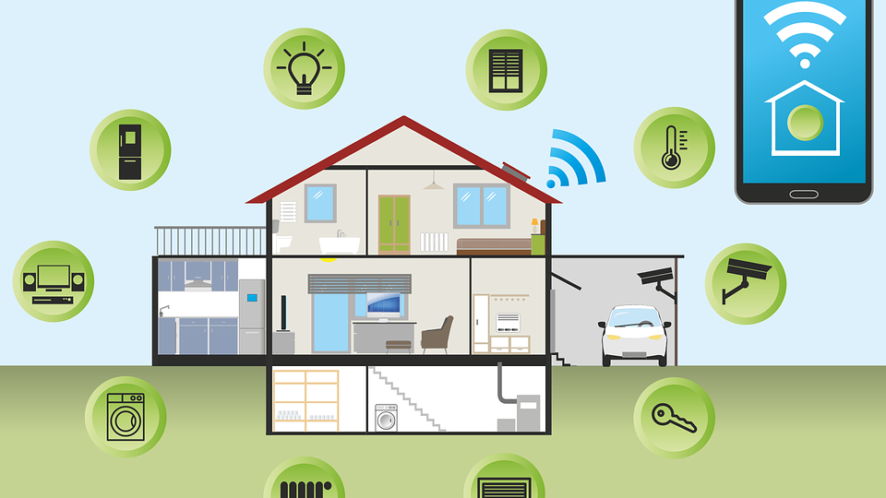
Applications:

Slide 11
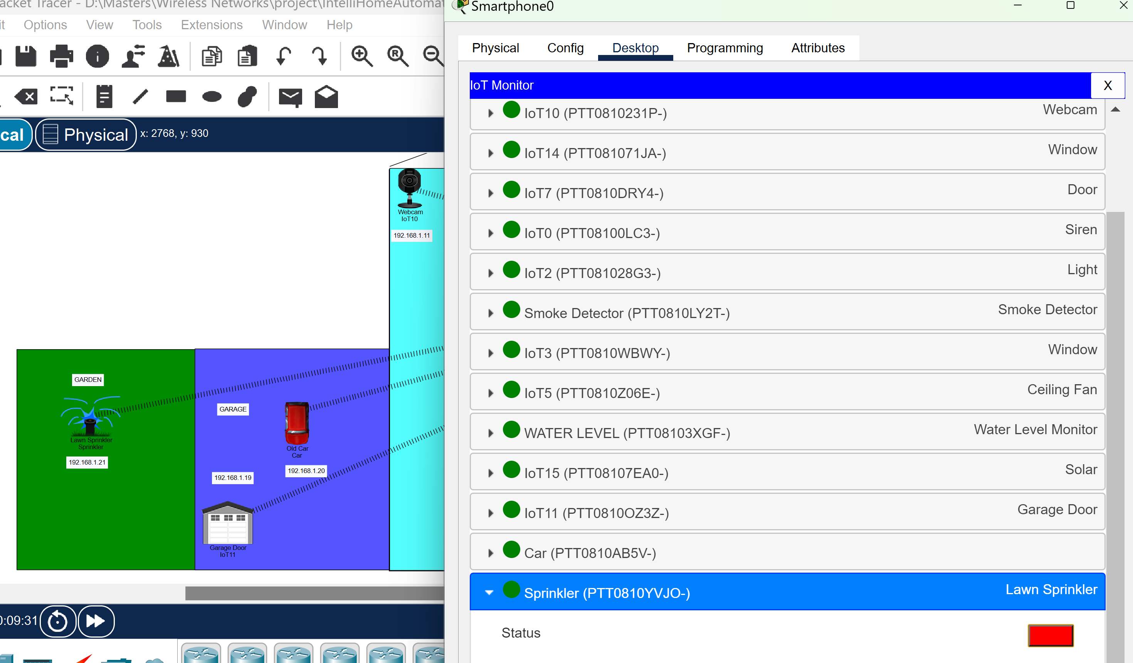
Results:

Slide 12
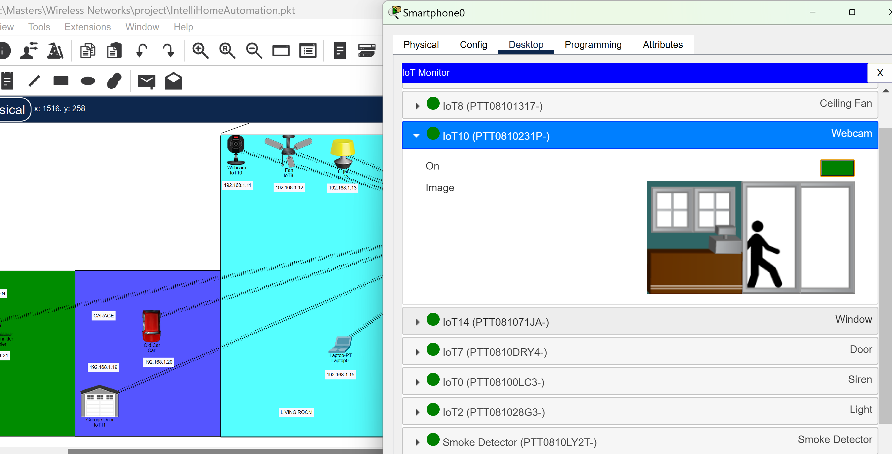

Slide 13
Conclusion:
We developed a system with numerous components that include an automated door system, windows, a water level monitor, a lawn sprinkler, a light, and a fan.
All things considered, a well-thought-out and executed IntelliHome automation system may significantly raise a house's level of comfort and convenience while enhancing security and energy efficiency.

Slide 14

Thank You

